Slide 1
BIO 201 Joints Lab

Slide 2
Knee Joints

Slide 3
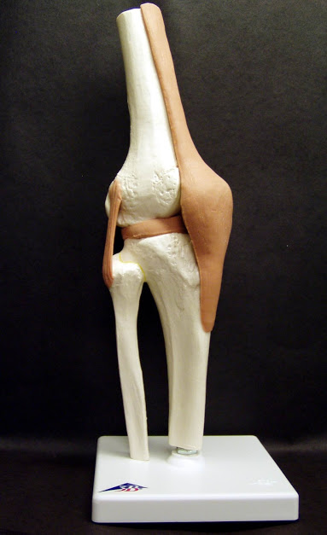
Tibiofemoral (Knee) Joint
Patellar ligament
Lateral (fibular) collateral ligament
Lateral meniscus
Anterolateral View

Slide 4
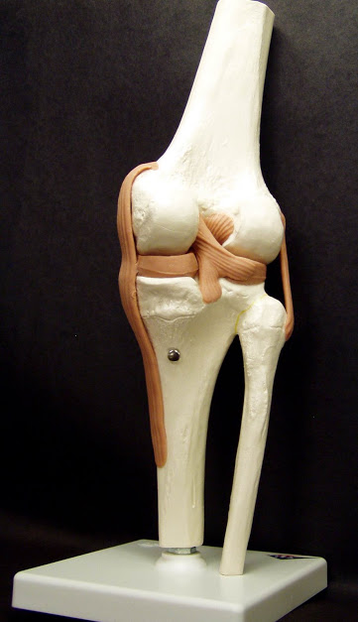
Tibiofemoral (Knee) Joint
Anterior cruciate ligament (ACL)
Posterior cruciate ligament
Lateral meniscus
Medial meniscus
Lateral (fibular) collateral ligament
Medial (tibial) collateral ligament
Posterior View

Slide 5
Hip Joints

Slide 6
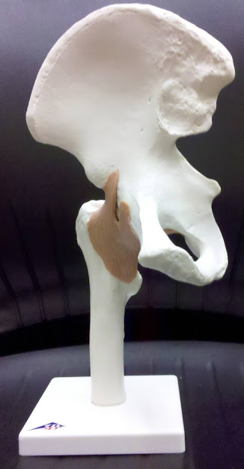
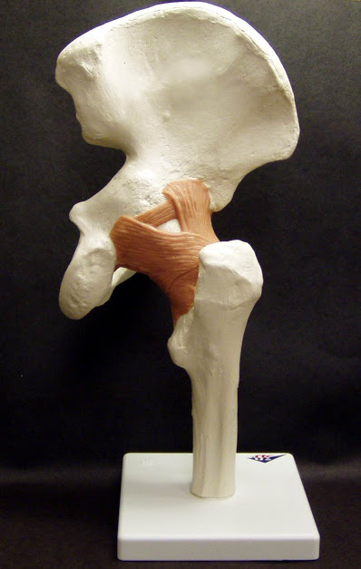
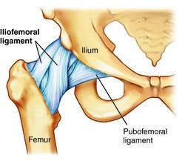
Hip (coxal) joint
Iliofemoral ligament
Iliofemoral ligament
Ischiofemoral ligament
Pubofemoral ligament
Posterior View
Anterior View

Slide 7
Iliofemoral ligament
Pubofemoral ligament
Posterior View

Slide 8
Shoulder Joints

Slide 9
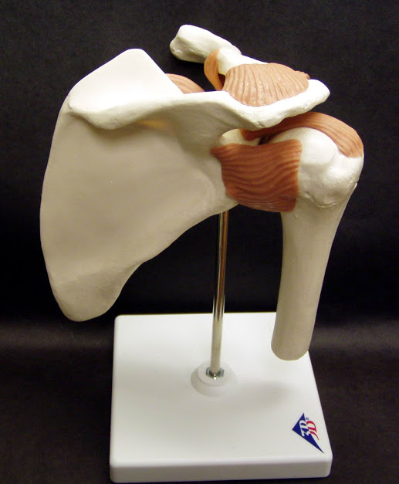
Glenohumeral (Shoulder) Joint
Acromioclavicularligament
Coracohumeral ligament
Posterior View

Slide 10
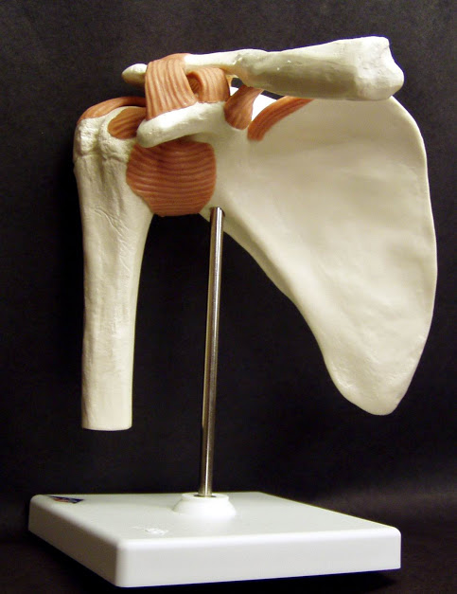
Coracoacromial ligament
Glenohumeral ligaments
Anterior View

